Slide 1
OS Security
Dr. Bhawana Rudra
NITK

Slide 2
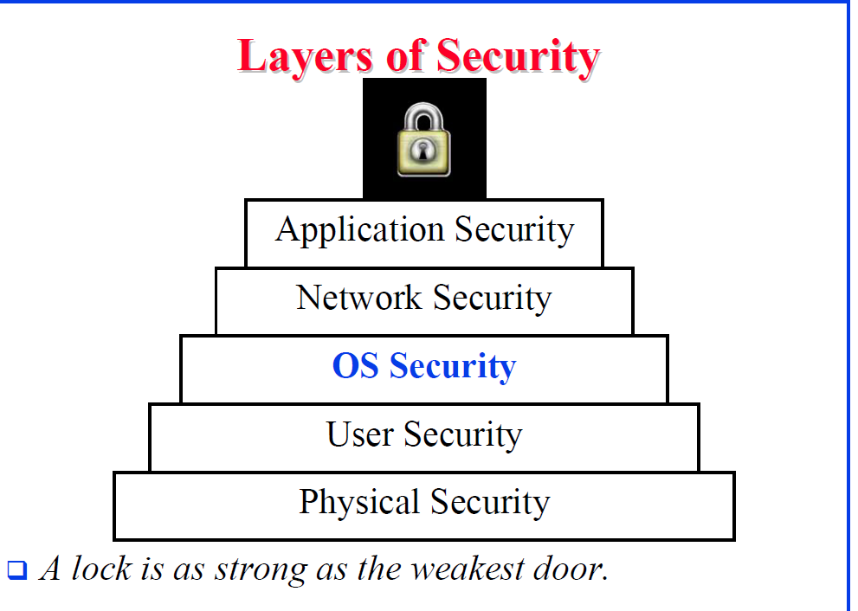

Slide 3
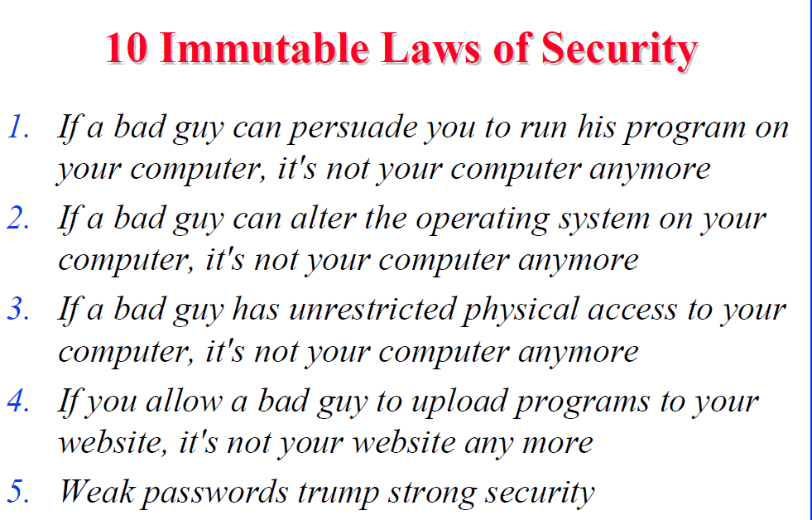

Slide 4
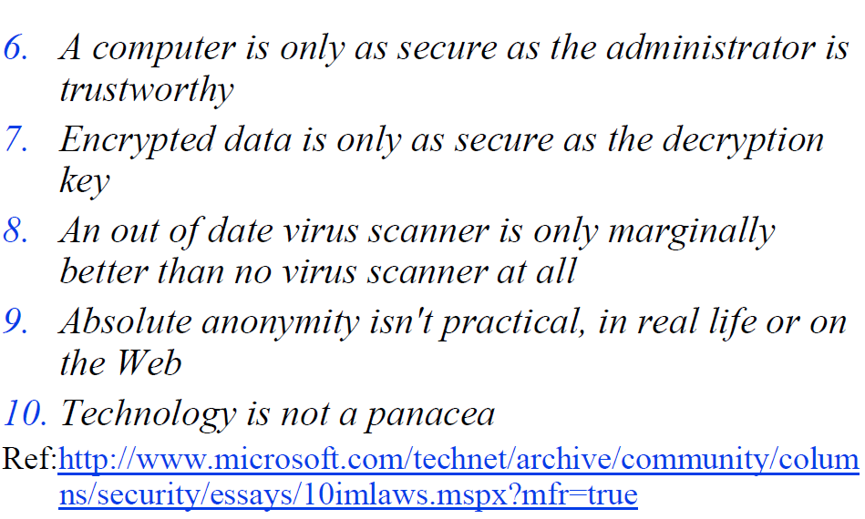

Slide 5
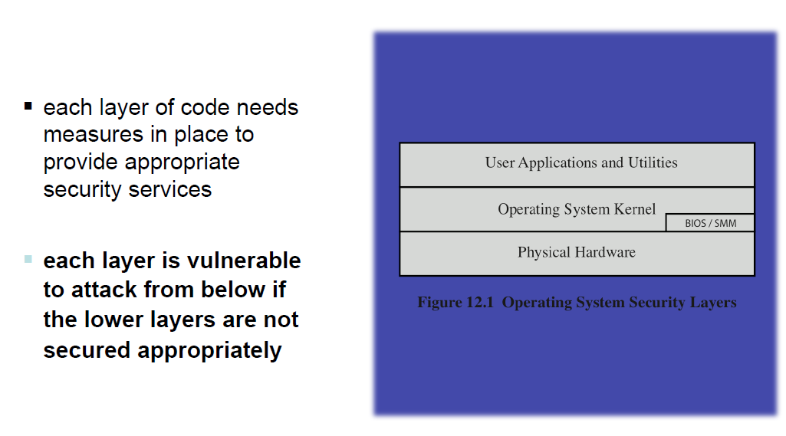
Operating System

Slide 6
Computer protection and security mechanisms provided by an operating system must address the following requirements:
Confidentiality: (or privacy) the requirement that information maintained by a computer system be accessible only by authorised parties (users and the processes that run as/represent those users).
Interception occurs when an unauthorised party gains access to a resource; examples include illicit file copying and the invocation of programs.
Integrity: the requirement that a computer system’s resources can be modified only by authorised parties.
Modification occurs when an unauthorised party not only gains access to but changes a resource such as data or the execution of a running process.
Availability: the requirement that a computer system be accessible at required times by authorised parties.
Interruption occurs when an unauthorised party reduces the availability of or to a resource.
Authenticity: the requirement that a computer system can verify the identity of a user.
Fabrication occurs when an unauthorised party inserts counterfeit data amongst valid data.

Slide 7
Assets and their Vulnerabilities
Hardware is mainly vulnerable to interruption, either by theft or by vandalism. Physical security measures are used to prevent these attacks.
Software is also vulnerable to interruption, as it is very easy to delete. Backups are used to limit the damage caused by deletion. Modification or fabrication through alteration (e.g. by viruses) is a major problem, as it can be hard to spot quickly. Software is also vulnerable to interception through unauthorised copying: this problem is still largely unsolved.
Data is vulnerable in many ways. Interruption can occur through the simple destruction of data files. Interception can occur through unauthorised reading of data files, or more perniciously through unauthorised analysis and aggregation of data. Modification and fabrication are also obvious problems with potentially huge consequences.
Communications are vulnerable to all types of threats.
Passive attacks take the form of eavesdropping, and fall into two categories: reading the contents of a message, or more subtly, analysing patterns of traffic to infer the nature of even secure messages.

Slide 8
Active attacks involve modification of a data stream, or creation of a false data stream. One entity may masquerade as another (presumably one with more or different privileges), maybe by capturing and replaying an authentication sequence. Replay is a similar attack, usually on data. Message contents may also be modified, often to induce incorrect behaviour in other users. Denial of service attacks aim to inhibit the normal use of communication facilities.
Active attacks are hard to prevent (entirely), so the emphasis is usually on detection and damage control.

Slide 9
possible for a system to be compromised during the installation process before it can install the latest patches
building and deploying a system should be a planned process designed to counter this threat
process must:
assess risks and plan the system deployment
secure the underlying operating system and then the key applications
ensure any critical content is secured
ensure appropriate network protection mechanisms are used
ensure appropriate processes are used to maintain security

Slide 10
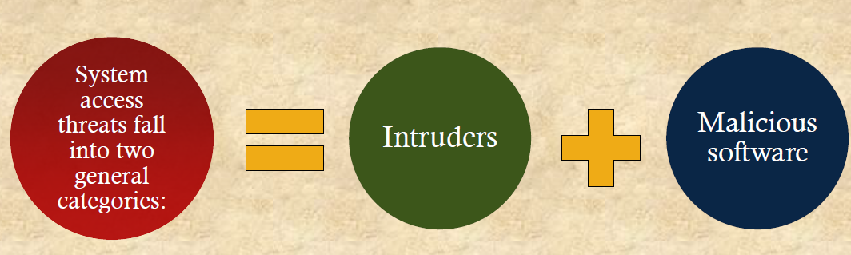
System Access Threats

Slide 11
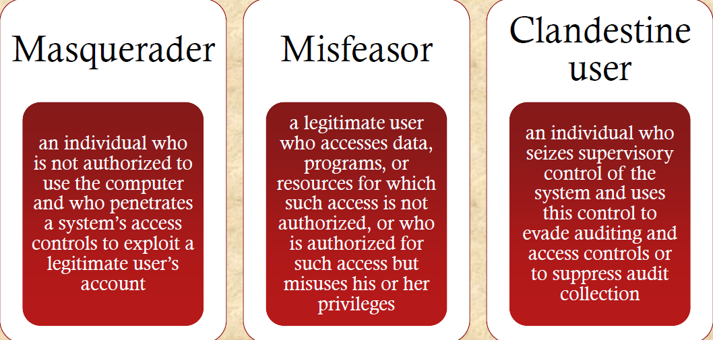
Intruders

Slide 12
Malicious Software
Programs that exploit vulnerabilities in computing systems
Also referred to as malware
Can be divided into two categories:
Parasitic
fragments of programs that cannot exist independently of some actual application program, utility, or system program
viruses, logic bombs, and backdoors are examples
independent
self-contained programs that can be scheduled and run by the operating system
worms and bot programs are examples

Slide 13
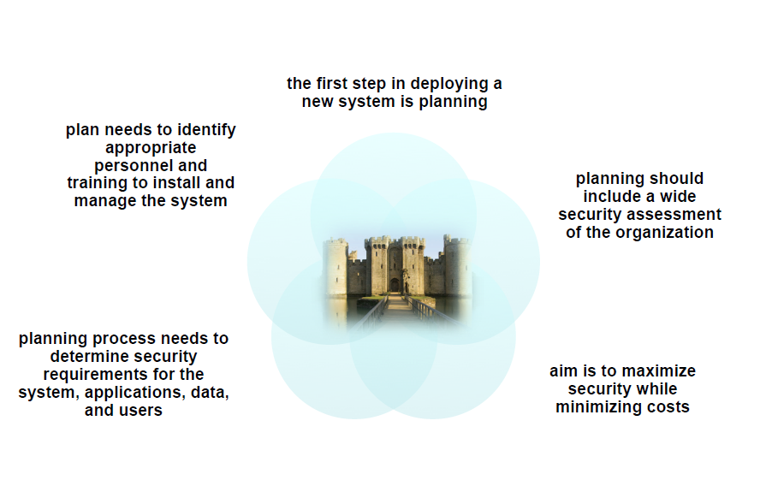
System Security Planning

Slide 14
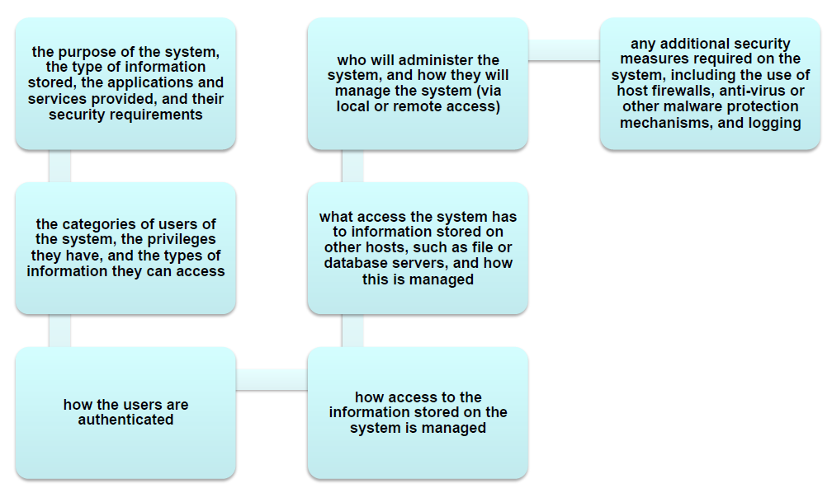
System Security Planning Process

Slide 15
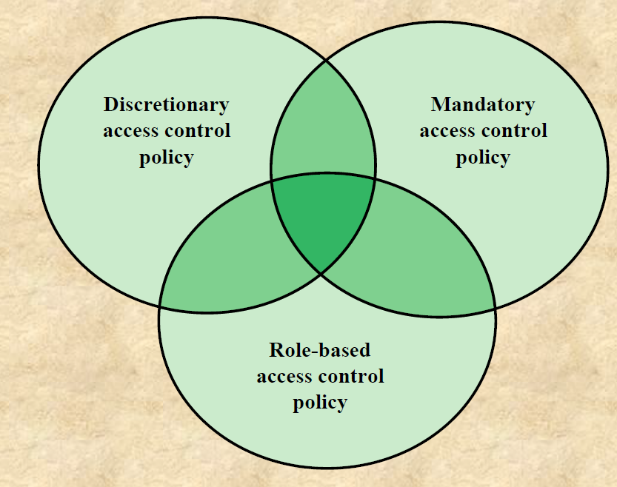

Slide 16
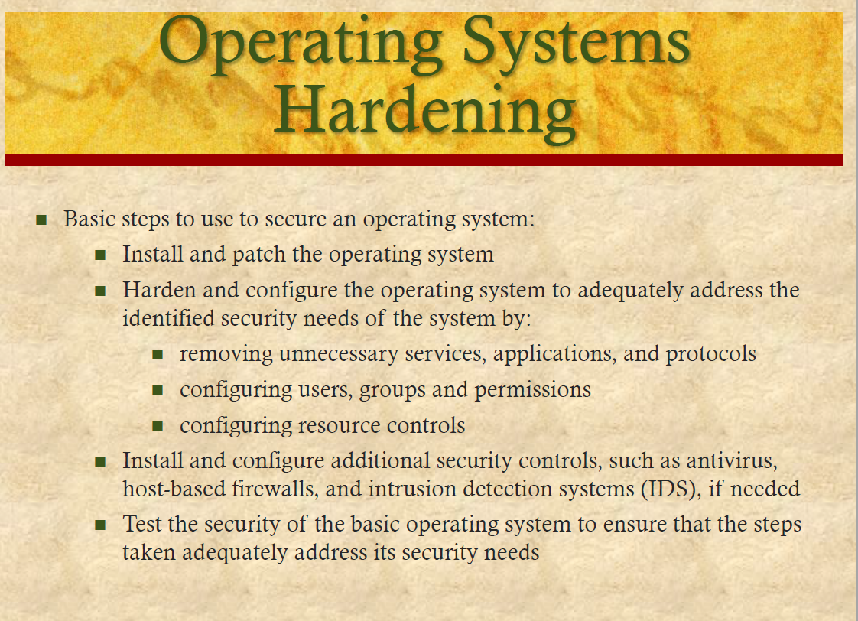

Slide 17
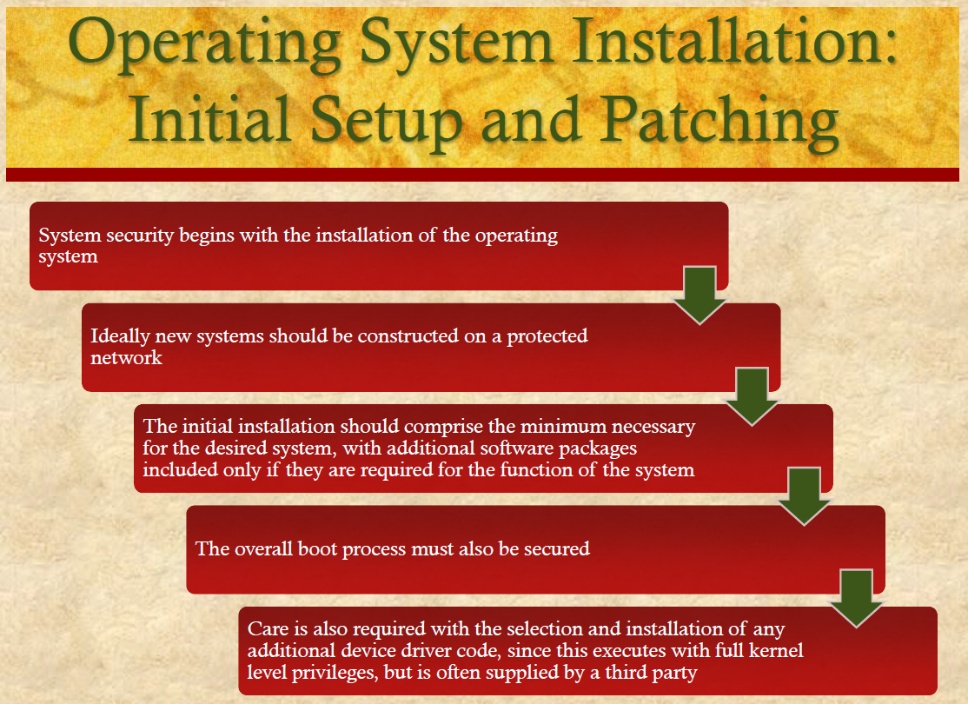

Slide 18
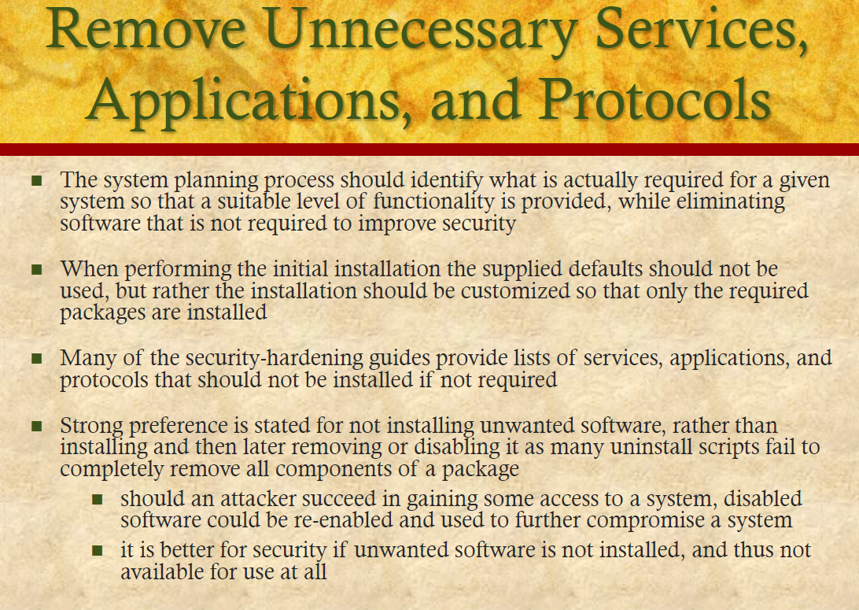

Slide 19
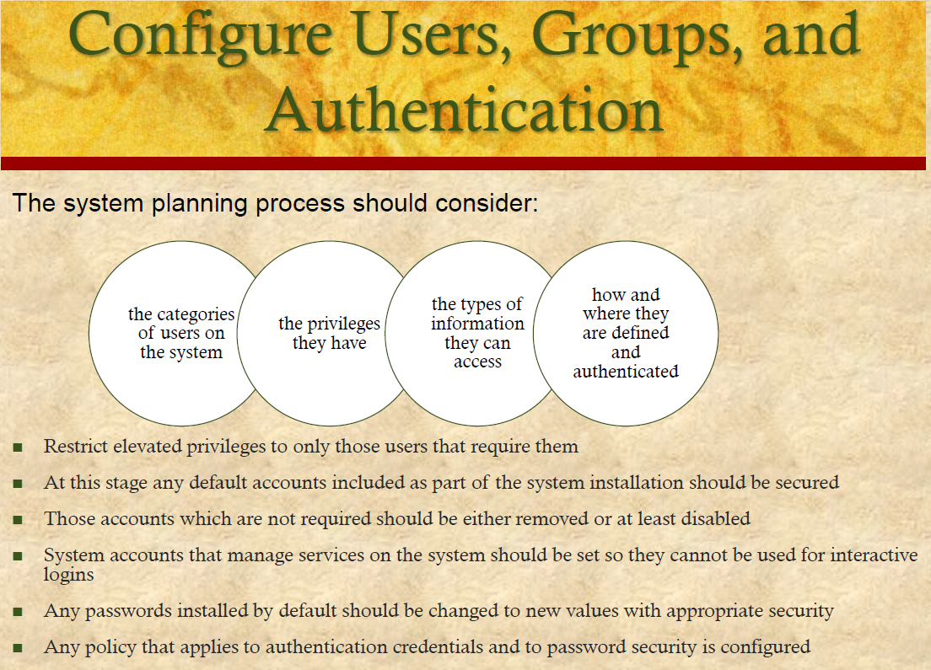

Slide 20
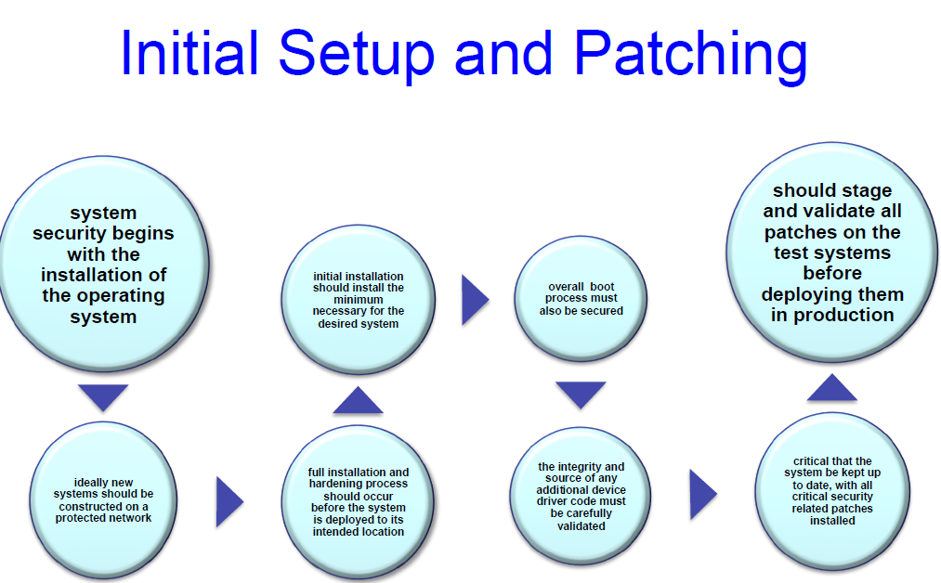

Slide 21
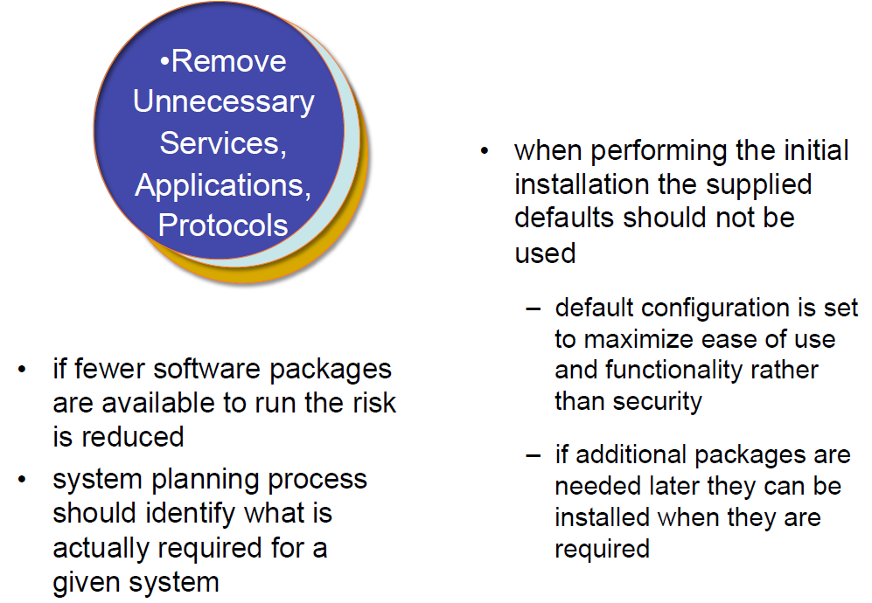

Slide 22
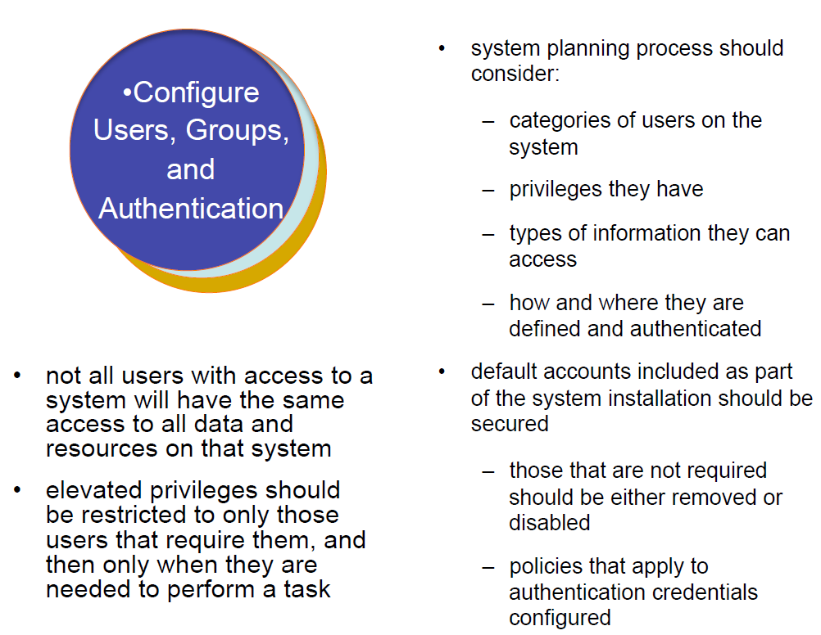

Slide 23
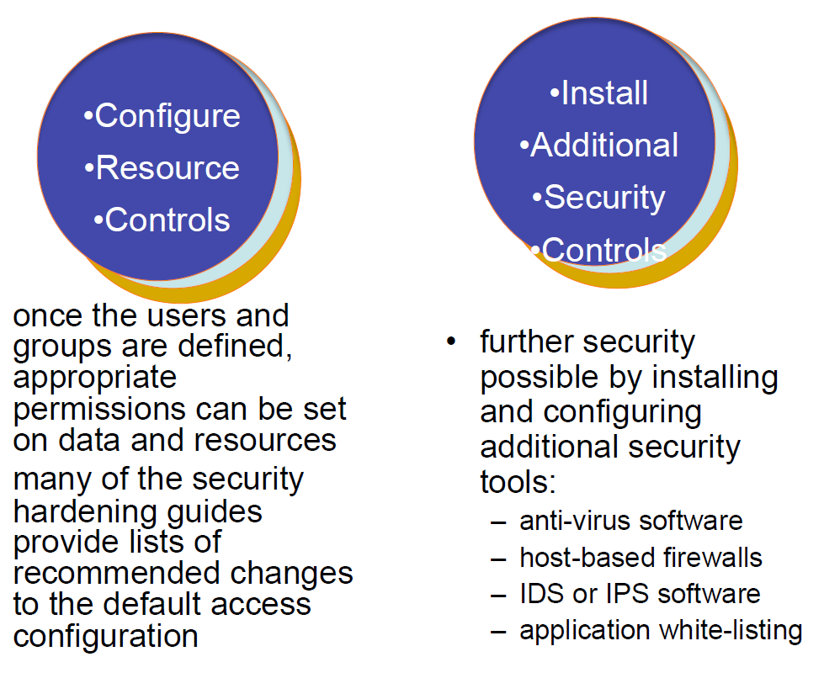

Slide 24
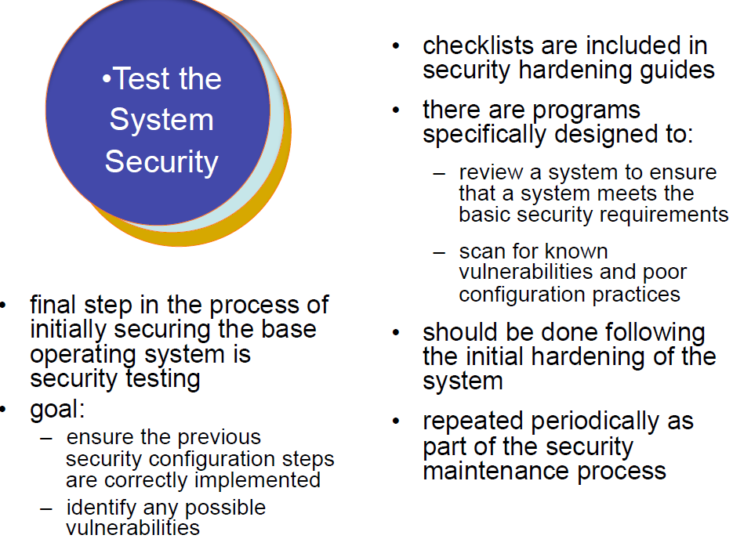

Slide 25
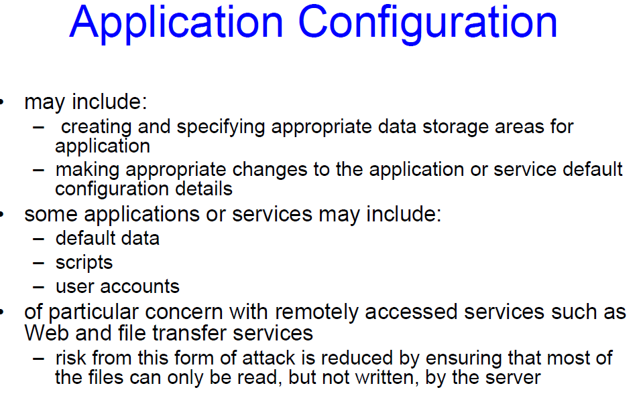

Slide 26
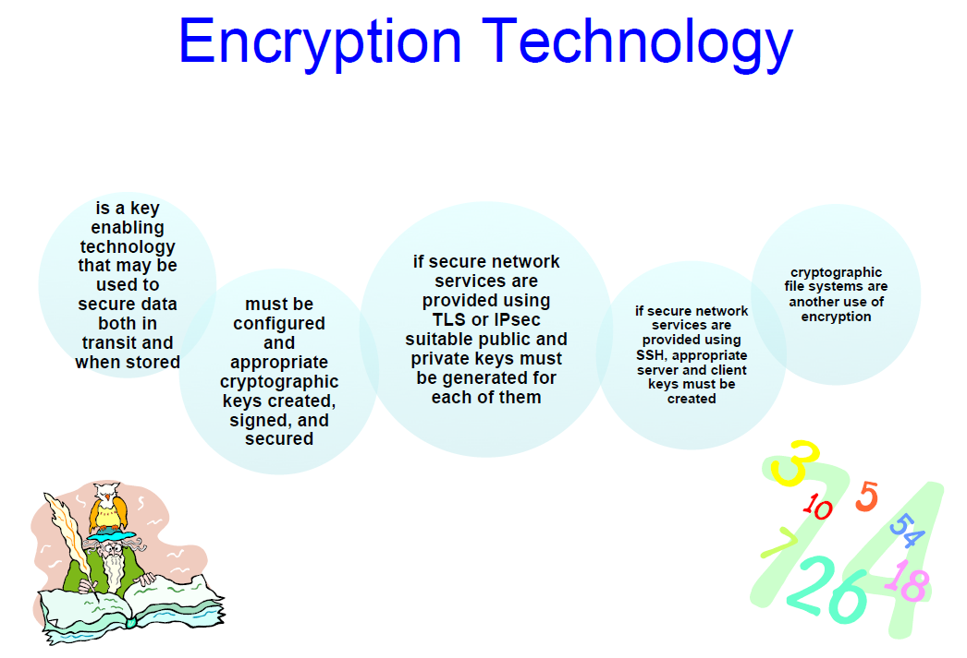

Slide 27
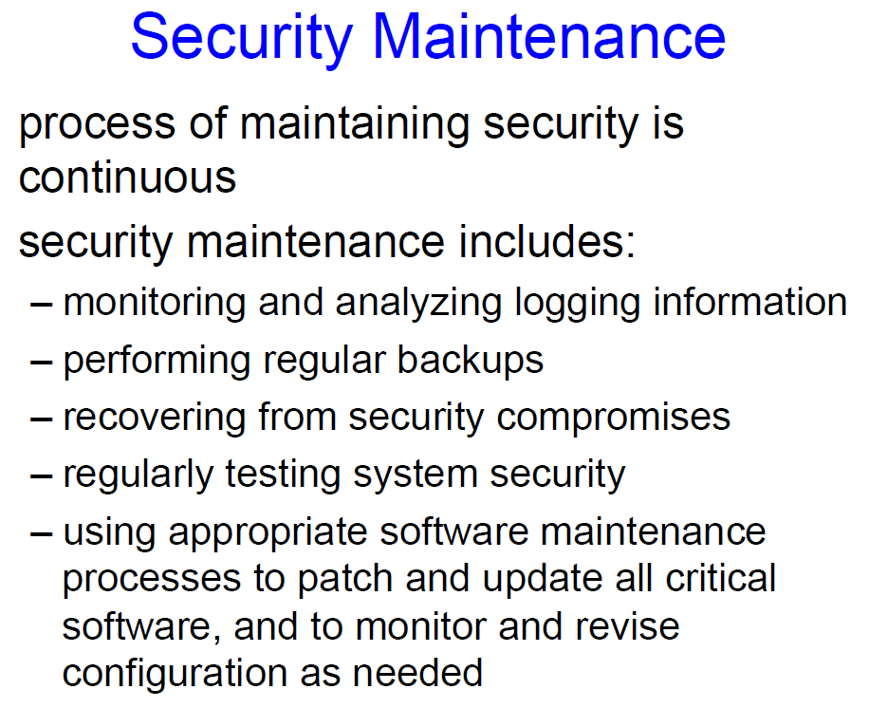

Slide 28
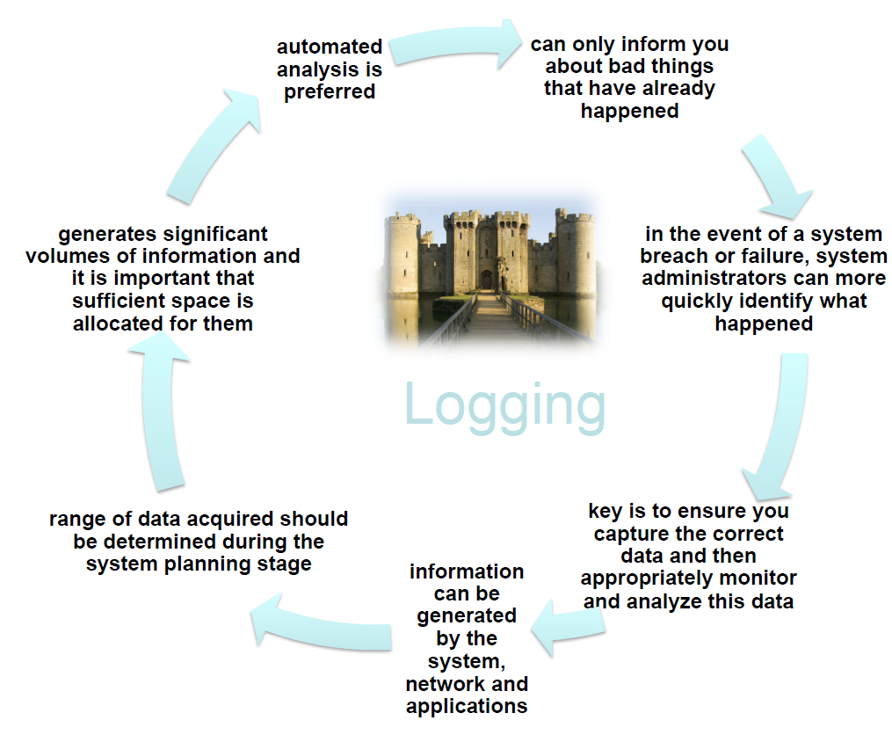

Slide 29
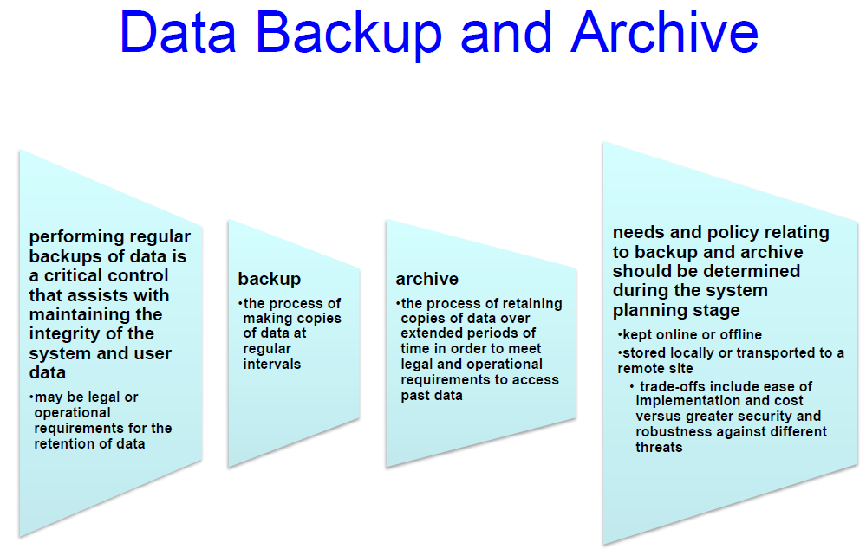

Slide 30
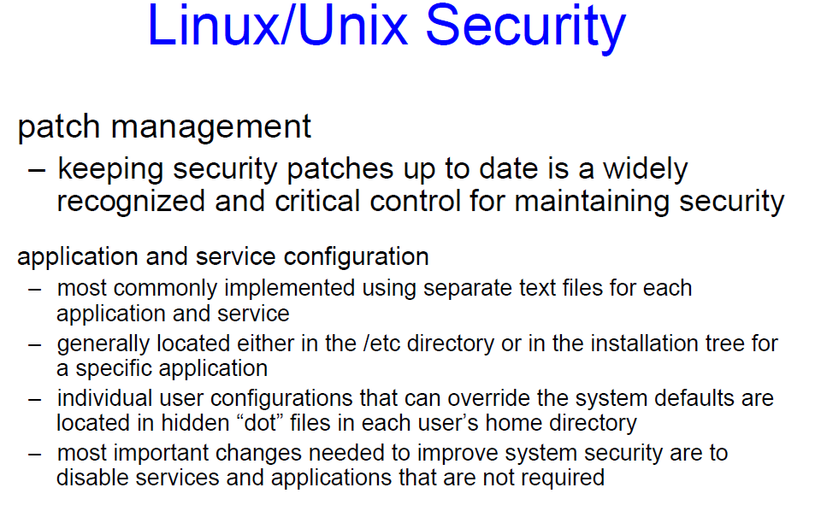

Slide 31
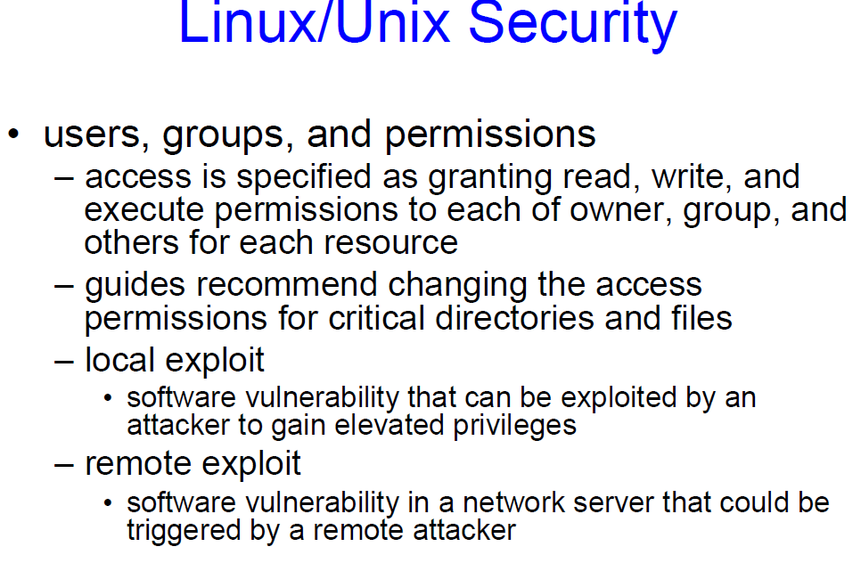

Slide 32
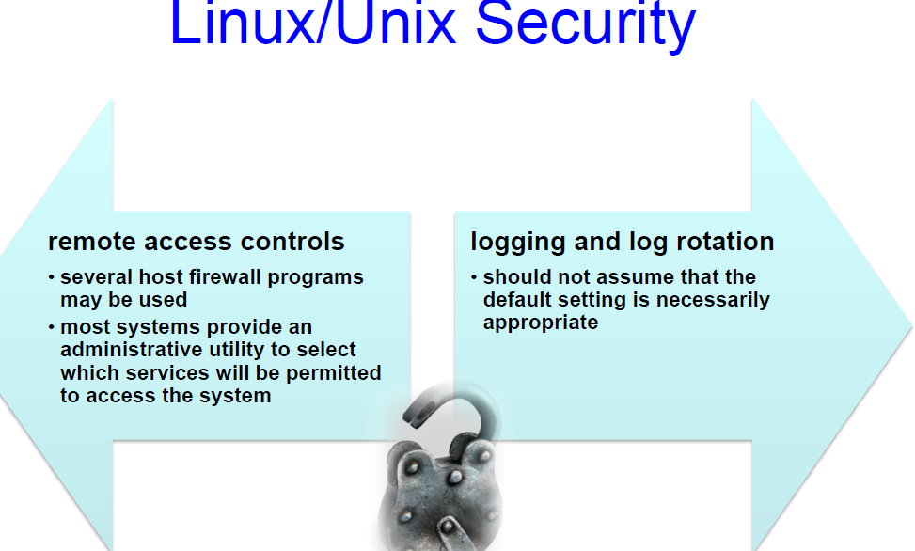

Slide 33
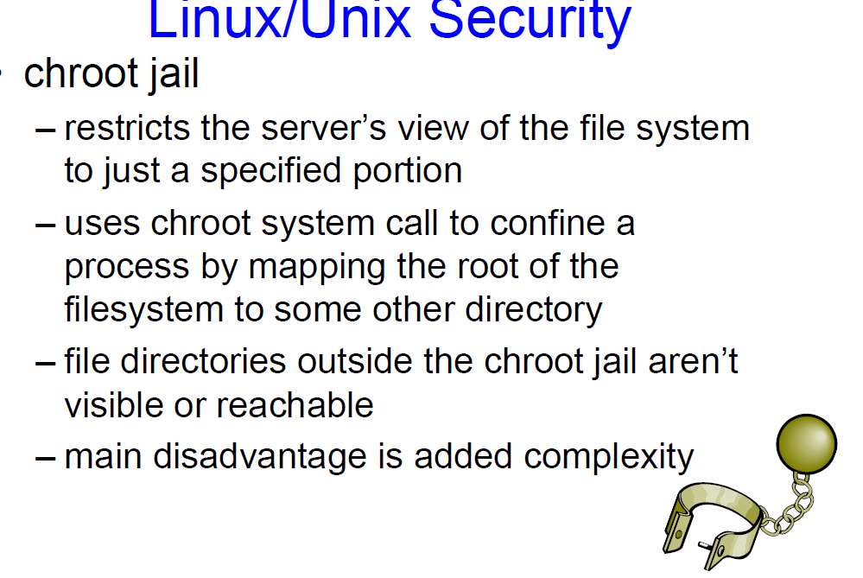

Slide 34
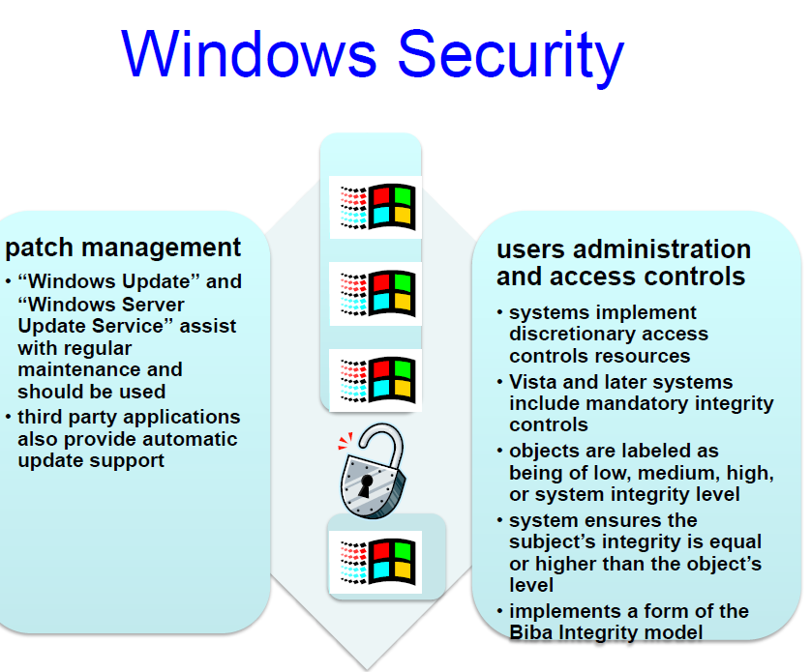

Slide 35
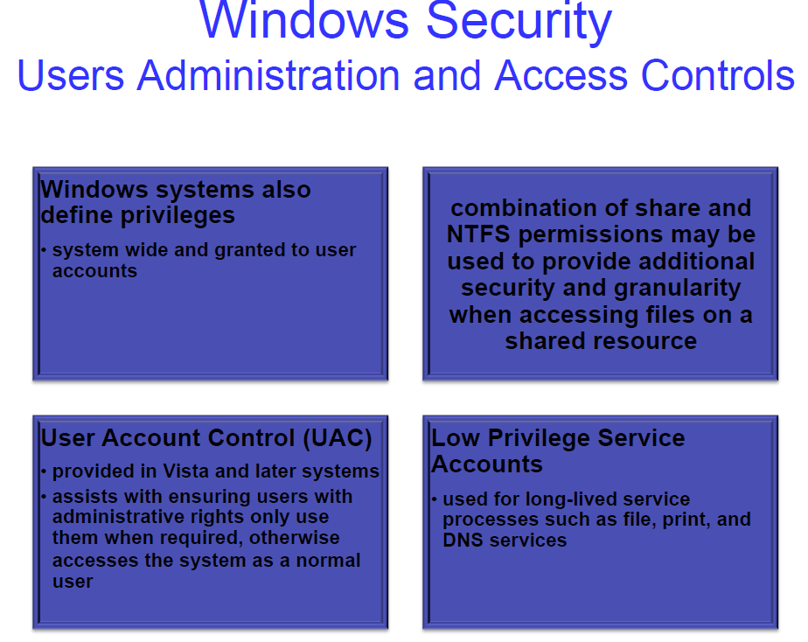

Slide 36
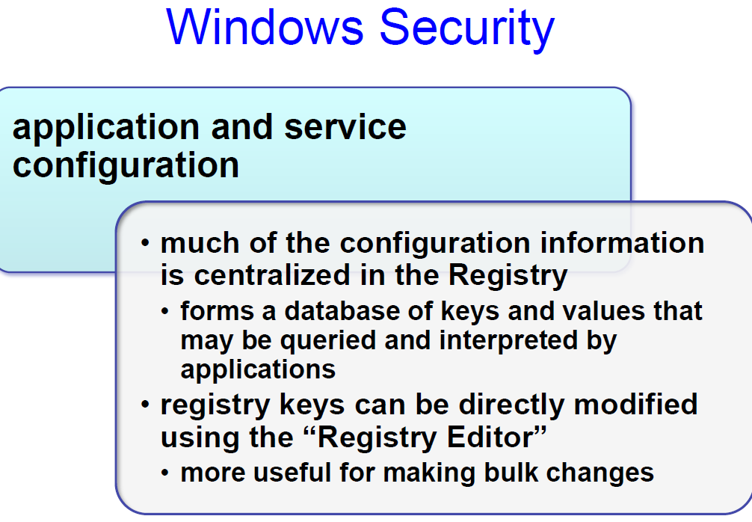

Slide 37
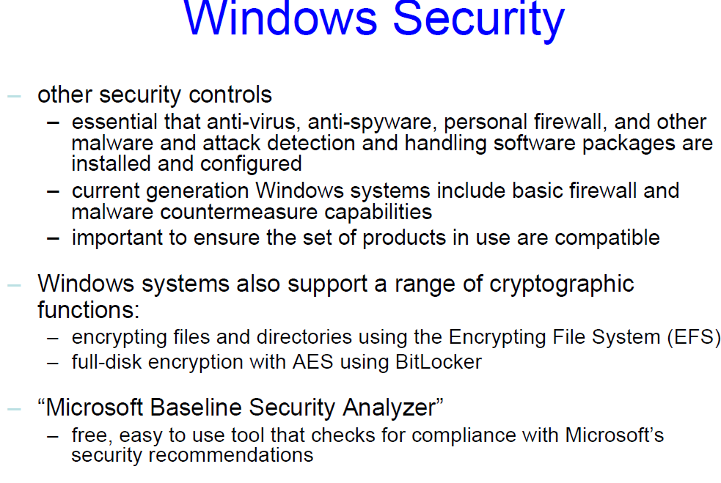

Slide 38
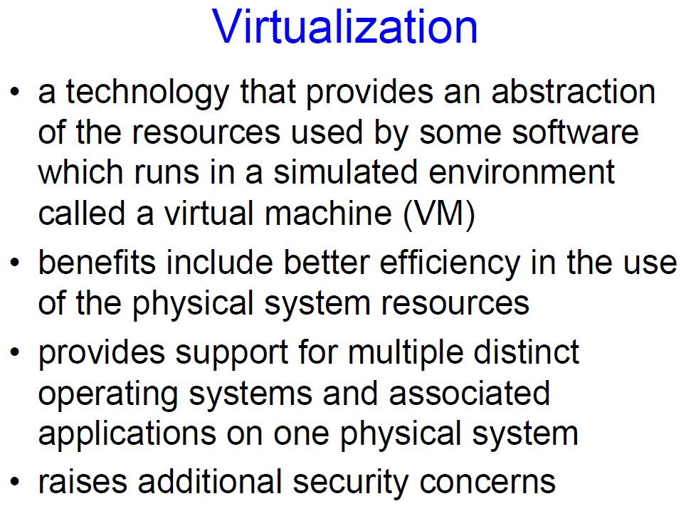

Slide 39
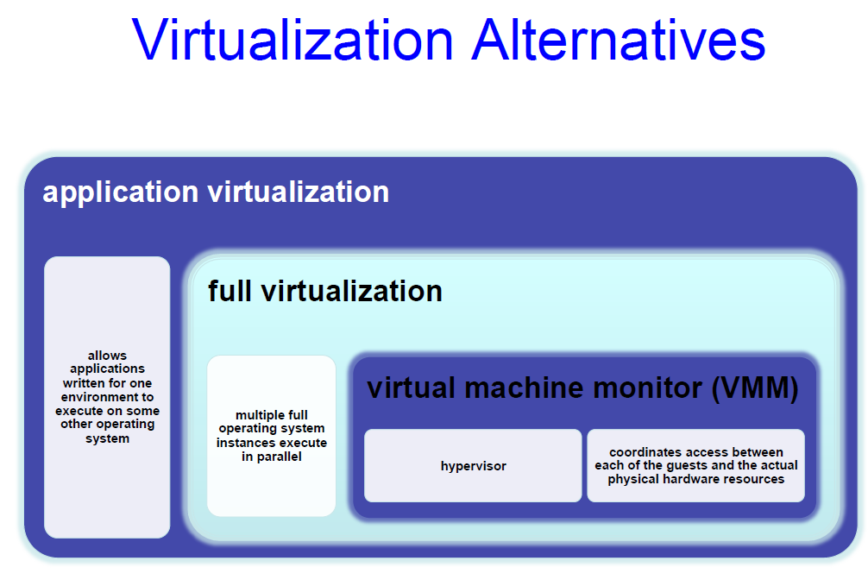

Slide 40
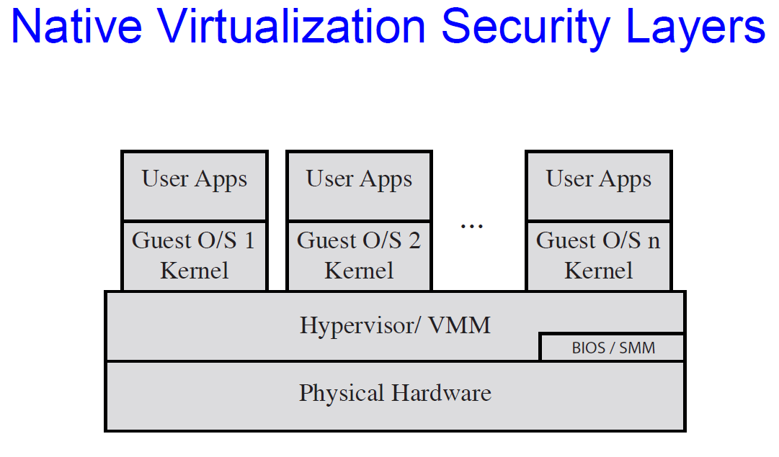

Slide 41
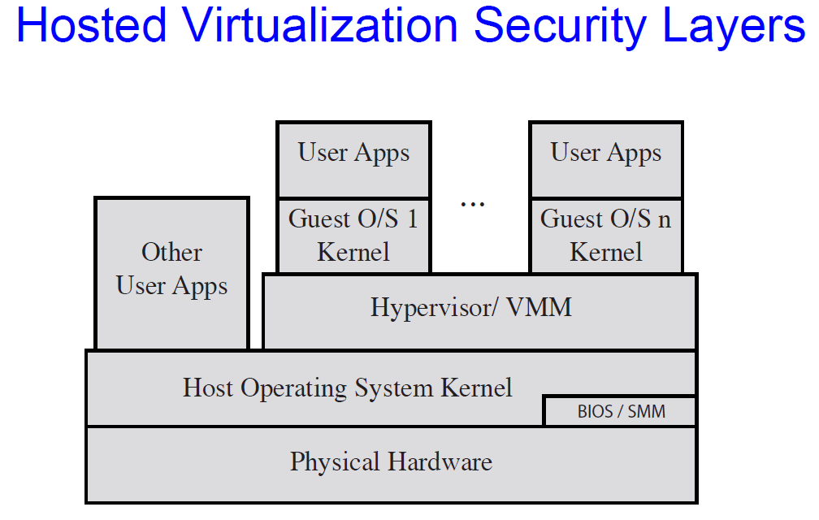

Slide 42
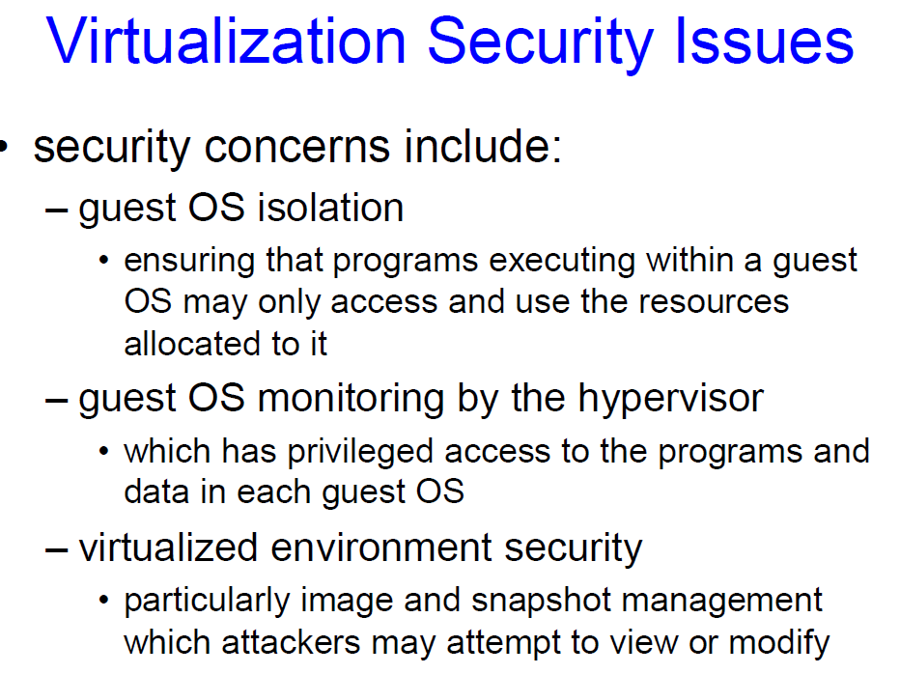

Slide 43
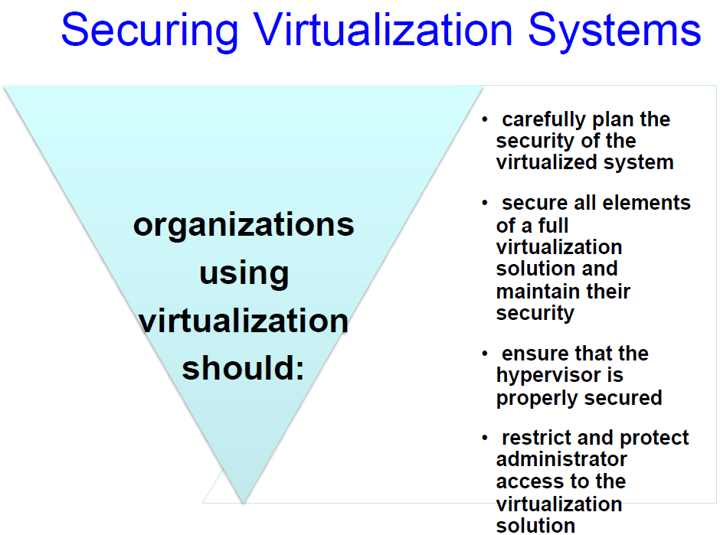

Slide 44
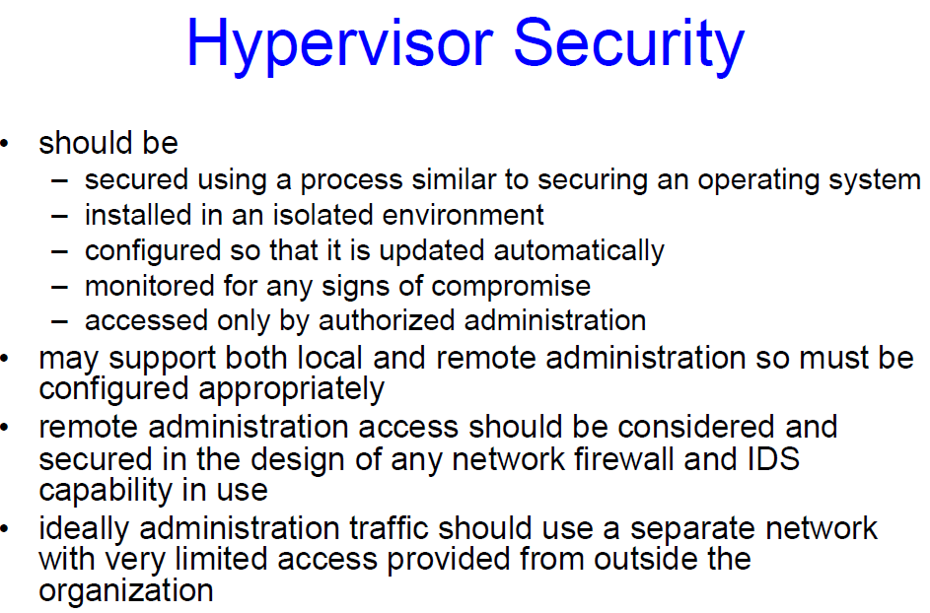

Slide 45
